Slide 1

CLINICAL INNOVATION REPORT
The Impact of AI on Modern Healthcare
Transforming Diagnostic Precision, Clinical Workflows, and Personalized Medicine
Department of Computer Science & Engineering

Slide 2



EXECUTIVE OVERVIEW
Accelerating Healthcare Transformation
+30%
-60%
500+
Diagnostic Accuracy
EHR Documentation Time
FDA-Cleared AI Devices
Deep learning models reduce radiologist misinterpretation rates
NLP transcription minimizes physician administrative burdens
Rapid clinical deployment across cardiology, radiology, and oncology

Slide 3
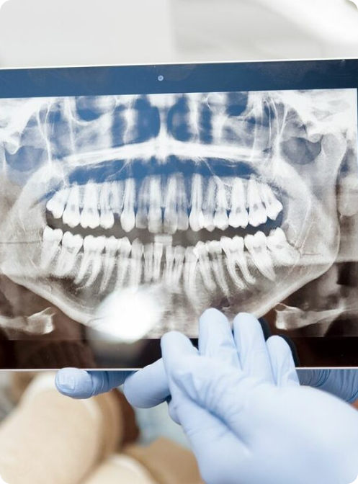

CLINICAL DOMAIN 01
AI in Diagnostic Medical Imaging
Early Lesion Detection
Convolutional neural networks detect early pulmonary nodules and micro-calcifications
Automated Triage
Prioritizes critical emergency scans instantly for urgent radiologist evaluation

Slide 4



CLINICAL DOMAIN 02
Personalized Medicine & Genomics
Genomic Sequencing
Targeted Drug Discovery
Biomarker Matching
Accelerates gene variant interpretation for customized oncology therapies.
Simulates molecular docking to identify drug candidates in months.
Matches specific patient profiles directly to specialized clinical trials.

Slide 5


OPERATIONAL EFFICIENCY
Administrative Workflow Automation
Ambient NLP Transcription
Converts doctor-patient dialogue into structured EHR clinical notes seamlessly
Automated Billing & Coding
Extracts diagnostic codes automatically to eliminate manual claim submission errors

Slide 6
CORE SYSTEM ARCHITECTURE
Key Pillars of AI-Enabled Healthcare Transformation
Bridging technical precision, surgical accuracy, and administrative speed across modern medical facilities.

Slide 7
SYSTEMIC IMPACT
Measurable Clinical Outcomes
Diagnostic Precision
Workflow Velocity
Burnout Reduction
Resource Allocation
Higher sensitivity in early-stage tumor detection.
Accelerated patient intake and triage processing.
Automated charting restores physician consultation focus.
Predictive ICU bed and staffing requirement models.

Slide 8


CLINICAL INNOVATION
Robotic-Assisted Surgery
Sub-Millimeter Motion Control
Filters physiological tremors during complex neurosurgical procedures
Faster Post-Op Recovery
Minimally invasive incisions shorten patient hospital stays significantly

Slide 9
IMPLEMENTATION FRAMEWORK
The Clinical AI Integration Pipeline
1
2
3
4
Data Ingestion
Model Validation
EHR Deployment
Real-World Audit
FHIR standard data aggregation across EHR systems.
Multi-center clinical trial testing for accuracy verification.
Real-time inference interface within doctor workflows.
Continuous post-market safety & drift tracking.

Slide 10

ETHICS & REGULATION
Governance & Ethical Safeguards
Patient Data Privacy
HIPAA compliance, zero-trust cloud encryption, and federated learning protocols
Explainable AI (XAI)
Eliminating "black box" decisions by generating clear visual attention heatmaps for clinicians

Slide 11
PARADIGM SHIFT
Traditional vs. AI-Enhanced Care
TRADITIONAL HEALTHCARE
AI-ENHANCED HEALTHCARE
Approach: Reactive symptomatic treatment
Approach: Predictive & preventive health intervention
Diagnostics: Manual scan interpretation
Diagnostics: Computer vision-assisted triage
Charting: Manual physician transcription
Charting: Ambient voice-to-text EHR automation
Therapy: Generalized medication standards
Therapy: Genome-tailored precision dosing

Slide 12

CONCLUSION
Empowering Clinicians, Elevating Care
AI serves as a force multiplier for clinical expertise, driving a safer and more responsive healthcare future.
Thank You — Questions & Discussion

Slide 13





Image Sources
https://media.istockphoto.com/id/2160720006/photo/medical-hospital-research-laboratory-caucasian-male-neurosurgeon-looking-at-tv-screen-with.jpg?s=612x612&w=0&k=20&c=KtLx7GkbI6Tw-FoS1YAnikEo9sQjrf-dm9zi5kaqebw=
Source: www.istockphoto.com
https://chatt-endo.com/wp-content/uploads/2024/03/Digital-Radiography.jpg
Source: chatt-endo.com
https://img.magnific.com/premium-photo/tablet-research-happy-black-man-doctor-internet-medical-healthcare-information-online-hospital-smile-medicine-professional-typing-health-website-app-modern-clinic_590464-285159.jpg
Source: www.magnific.com
https://www.toplinemd.com/advanced-surgical-physicians/wp-content/uploads/sites/14/2025/08/Advanced-Surgical-Physicians-Robotic-Assisted-Surgery-scaled.jpg
Source: www.toplinemd.com
https://www.wolterskluwer.com/cdn-images/3087481-young-nurse-checking-appointments-list-on-digital-tablet-in-busy-medical-office-b2756c4c57?v=ce2196e8&q=80
Source: www.wolterskluwer.com

